Slide 1


Automatic Test-Case Reduction in Proof Assistants A Case Study in Coq
Jason Gross, Théo Zimmermann, Miraya Poddar-Agrawal, and Adam Chlipala
Notes:
(Give name if not introduced)
MIT logo from https://upload.wikimedia.org/wikipedia/commons/0/0c/MIT_logo.svg
INRIA from https://www.inria.fr/en/charter-use-visual-identity-inria

Slide 2
Category Theory Library Minimization in Coq
Notes:
“Formalizing category theory in a library” not “formalizing a category theory library”

Slide 3
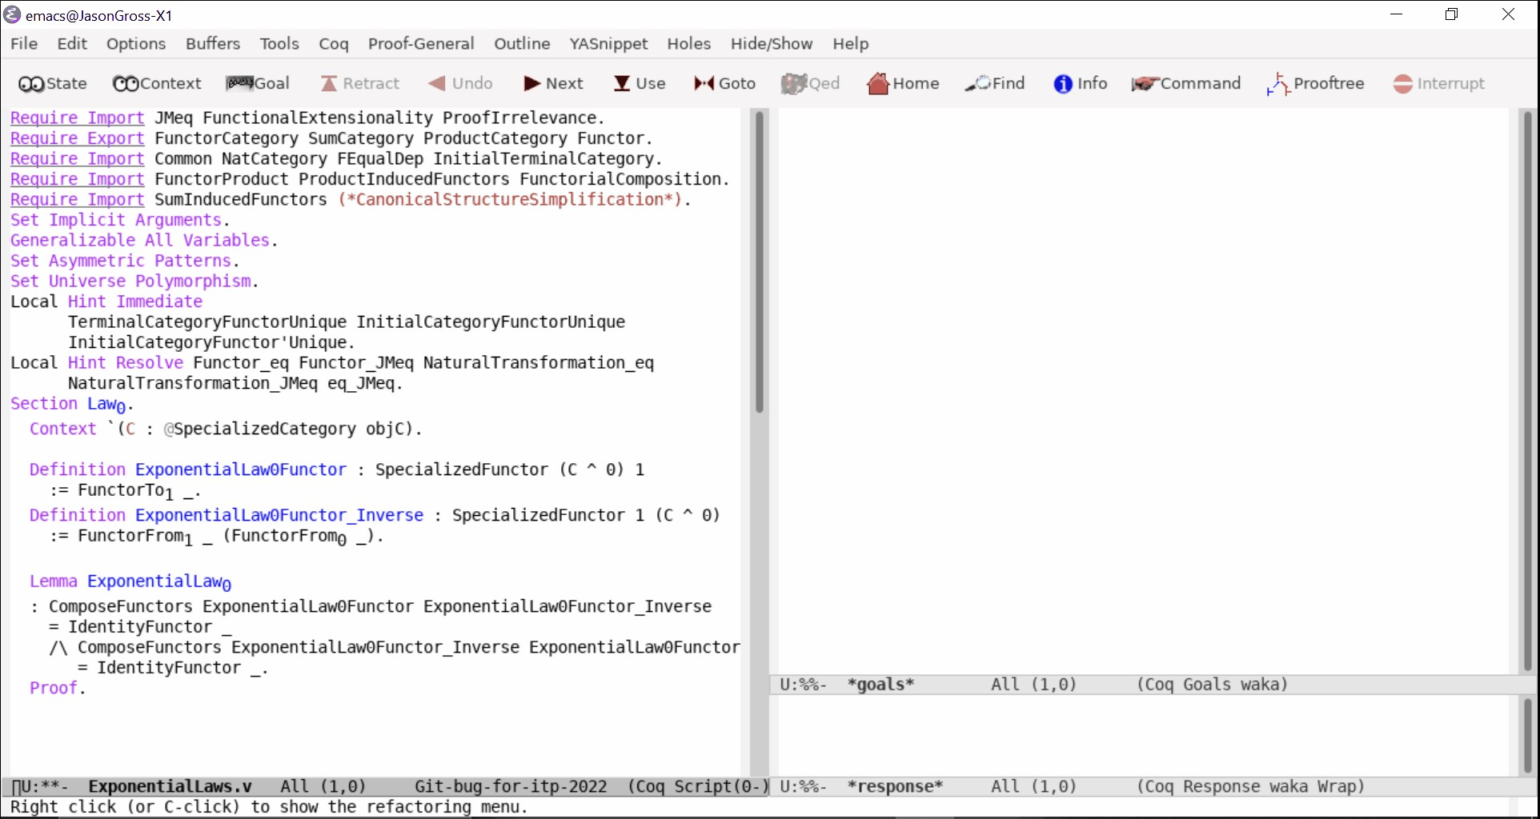
Category Theory Library Minimization in Coq
Notes:
https://github.com/HoTT/coq/issues/7

Slide 4
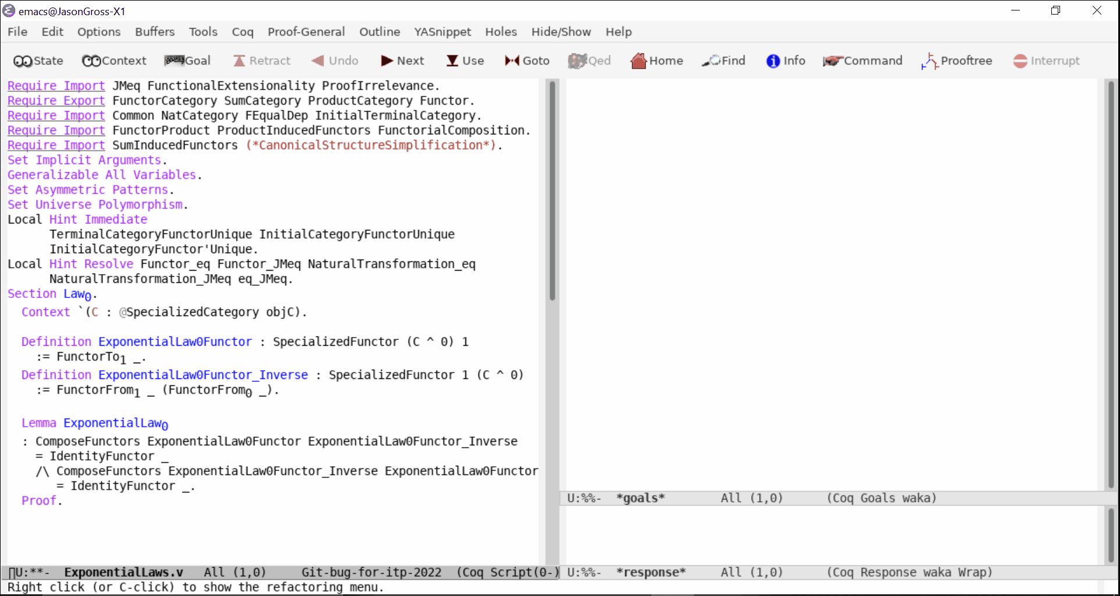
Category Theory Library Minimization in Coq
Notes:
https://github.com/HoTT/coq/issues/7
Almost 3000 lines of code across 20 dependencies
Files: Notations.v Common.v FEqualDep.v StructureEquality.v SpecializedCategory.v Category.v DiscreteCategory.v NatCategory.v Functor.v InitialTerminalCategory.v ProductCategory.v SumCategory.v NaturalTransformation.v FunctorCategory.v ProductInducedFunctors.v SumInducedFunctors.v FunctorialComposition.v TypeclassUnreifiedSimplification.v FunctorProduct.v LtacReifiedSimplification.v
spec proof comments
37 0 4 Notations.v
788 78 72 Common.v
104 69 0 FEqualDep.v
22 0 0 StructureEquality.v
205 50 20 SpecializedCategory.v
63 0 9 Category.v
20 16 0 DiscreteCategory.v
11 0 0 NatCategory.v
215 58 12 Functor.v
38 19 0 InitialTerminalCategory.v
28 9 0 ProductCategory.v
43 18 1 SumCategory.v
285 83 68 NaturalTransformation.v
12 9 1 FunctorCategory.v
30 28 0 ProductInducedFunctors.v
32 41 0 SumInducedFunctors.v
12 19 0 FunctorialComposition.v
153 36 14 TypeclassUnreifiedSimplification.v
29 19 1 FunctorProduct.v
195 100 9 LtacReifiedSimplification.v
2322 652 211 total

Slide 5
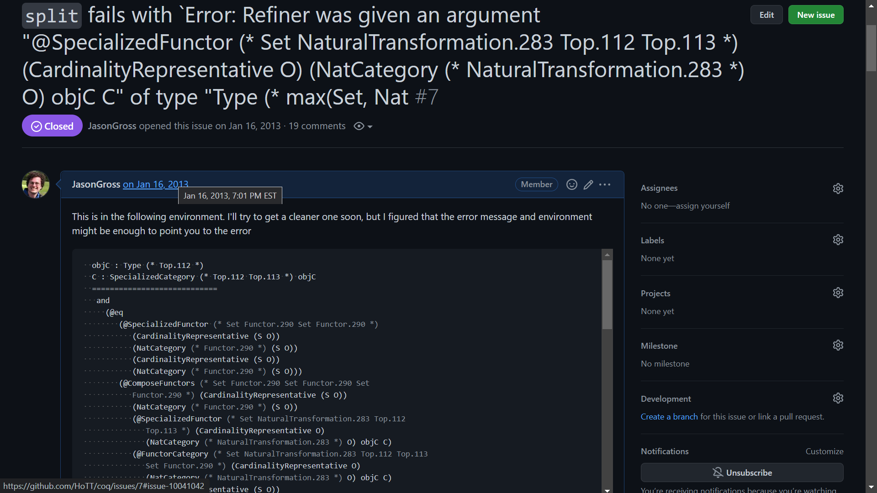
Notes:
Almost 3000 lines of code across 20 dependencies
Files: Notations.v Common.v FEqualDep.v StructureEquality.v SpecializedCategory.v Category.v DiscreteCategory.v NatCategory.v Functor.v InitialTerminalCategory.v ProductCategory.v SumCategory.v NaturalTransformation.v FunctorCategory.v ProductInducedFunctors.v SumInducedFunctors.v FunctorialComposition.v TypeclassUnreifiedSimplification.v FunctorProduct.v LtacReifiedSimplification.v

Slide 6
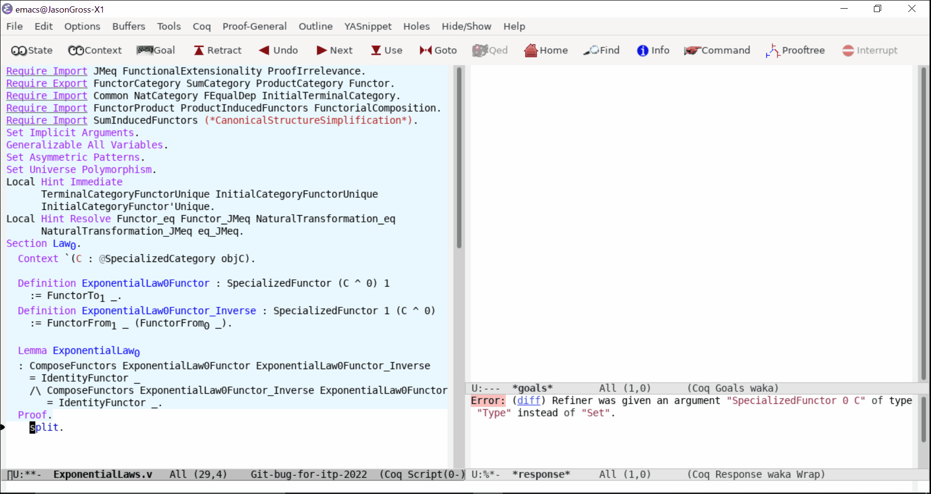

Slide 7
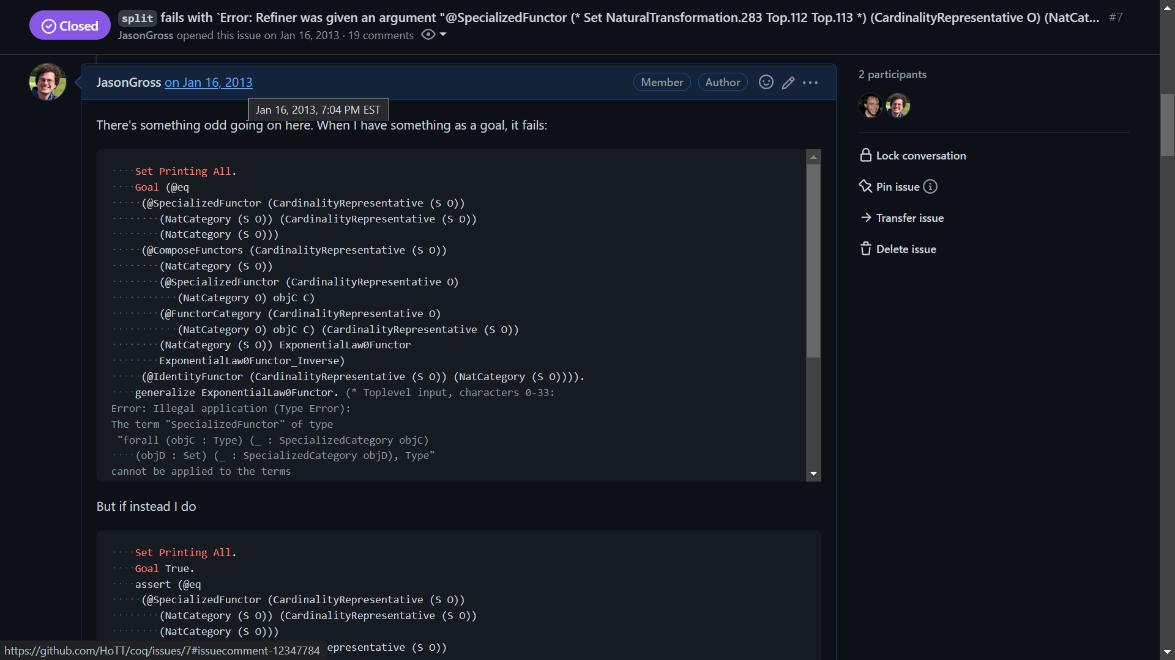

Slide 8
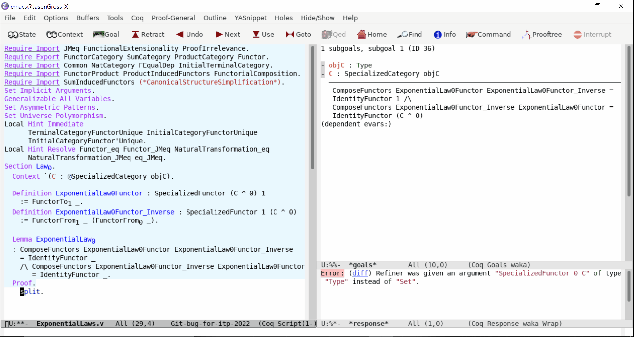
Category Theory Library Minimization in Coq
Notes:
Now I need to back up, and undo that last change.

Slide 9
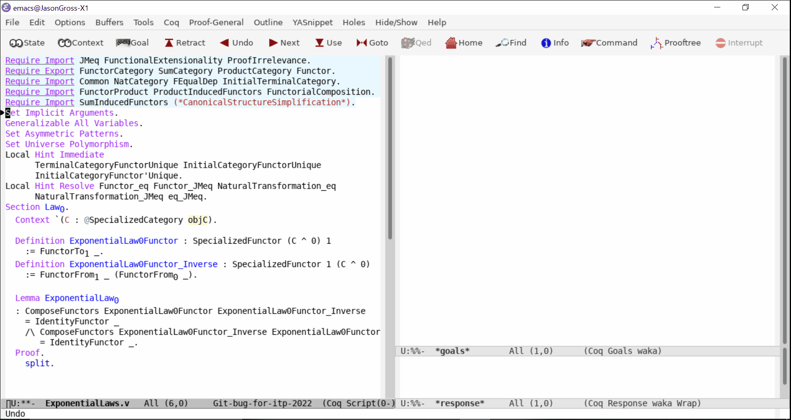
Category Theory Library Minimization in Coq
Notes:
(Don’t say “things” say “delete tokens”)
Unfriendly to report a bug of almost 2200 loc spread across 13 files
12 dependencies
Deps: Notations.v Common.v FEqualDep.v StructureEquality.v SpecializedCategory.v Category.v DiscreteCategory.v NatCategory.v Functor.v InitialTerminalCategory.v NaturalTransformation.v FunctorCategory.v
spec proof comments
37 0 4 Notations.v
788 78 72 Common.v
104 69 0 FEqualDep.v
22 0 0 StructureEquality.v
205 50 20 SpecializedCategory.v
63 0 9 Category.v
20 16 0 DiscreteCategory.v
11 0 0 NatCategory.v
215 58 12 Functor.v
38 19 0 InitialTerminalCategory.v
285 83 68 NaturalTransformation.v
12 9 1 FunctorCategory.v
1800 382 186 total

Slide 10
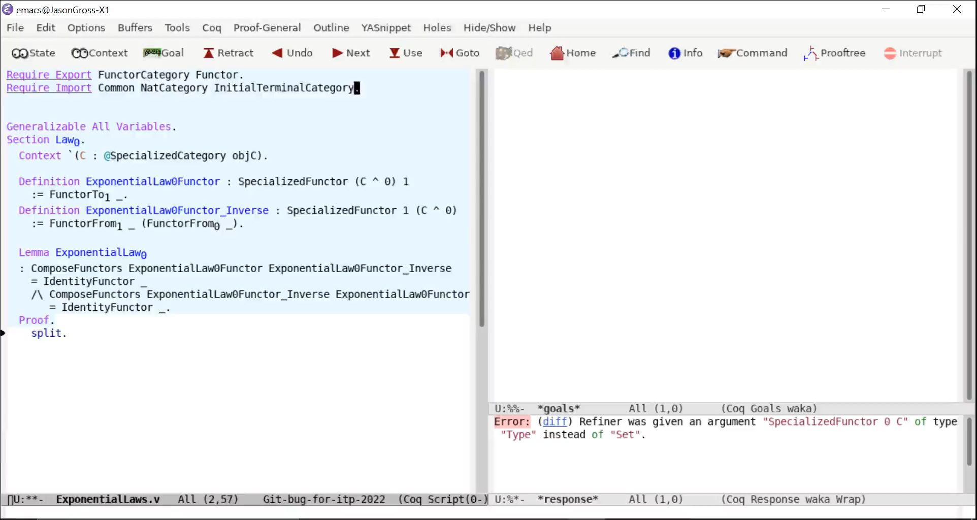
Category Theory Library Minimization in Coq
Notes:
(Don’t say “things” say “delete tokens”)
Say early on that we want to inline dependencies (b/c fewer uploaded files make for an easier debugging experience and less complexity) and this causes the file to grow
Unfriendly to report a bug of almost 2200 loc spread across 13 files
12 dependencies
Deps: Notations.v Common.v FEqualDep.v StructureEquality.v SpecializedCategory.v Category.v DiscreteCategory.v NatCategory.v Functor.v InitialTerminalCategory.v NaturalTransformation.v FunctorCategory.v
spec proof comments
37 0 4 Notations.v
788 78 72 Common.v
104 69 0 FEqualDep.v
22 0 0 StructureEquality.v
205 50 20 SpecializedCategory.v
63 0 9 Category.v
20 16 0 DiscreteCategory.v
11 0 0 NatCategory.v
215 58 12 Functor.v
38 19 0 InitialTerminalCategory.v
285 83 68 NaturalTransformation.v
12 9 1 FunctorCategory.v
1800 382 186 total

Slide 11
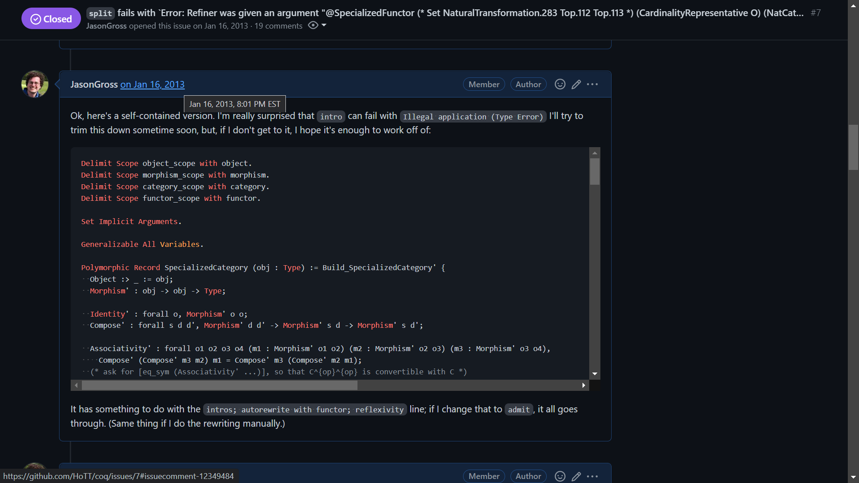
Notes:
After an hour of work (not all shown on the previous slide), I had a slightly nicer standalone file.

Slide 12
Origin Story: Coq Bug Reports By Year
Notes:
Of the ≈9000 issues reported, I’ve reported over 1900.
This project started because I got tired of manually minimizing test-cases for reporting bugs in Coq.
The first commit dates to April 2013, and you can see a corresponding jump in my ability to report bugs from 2013 to 2014.
(The next-most prolific reporter is at 226.)
GitHub transition happened in October 2017
Plot includes everyone who’s reported more than three issues ever; all of the three-and-under contributors are lumped together and displayed up top due to limitations in how many distinct stacks Excel is willing to include in a stacked column chart.

Slide 13
Goal: Automate This!

Slide 14
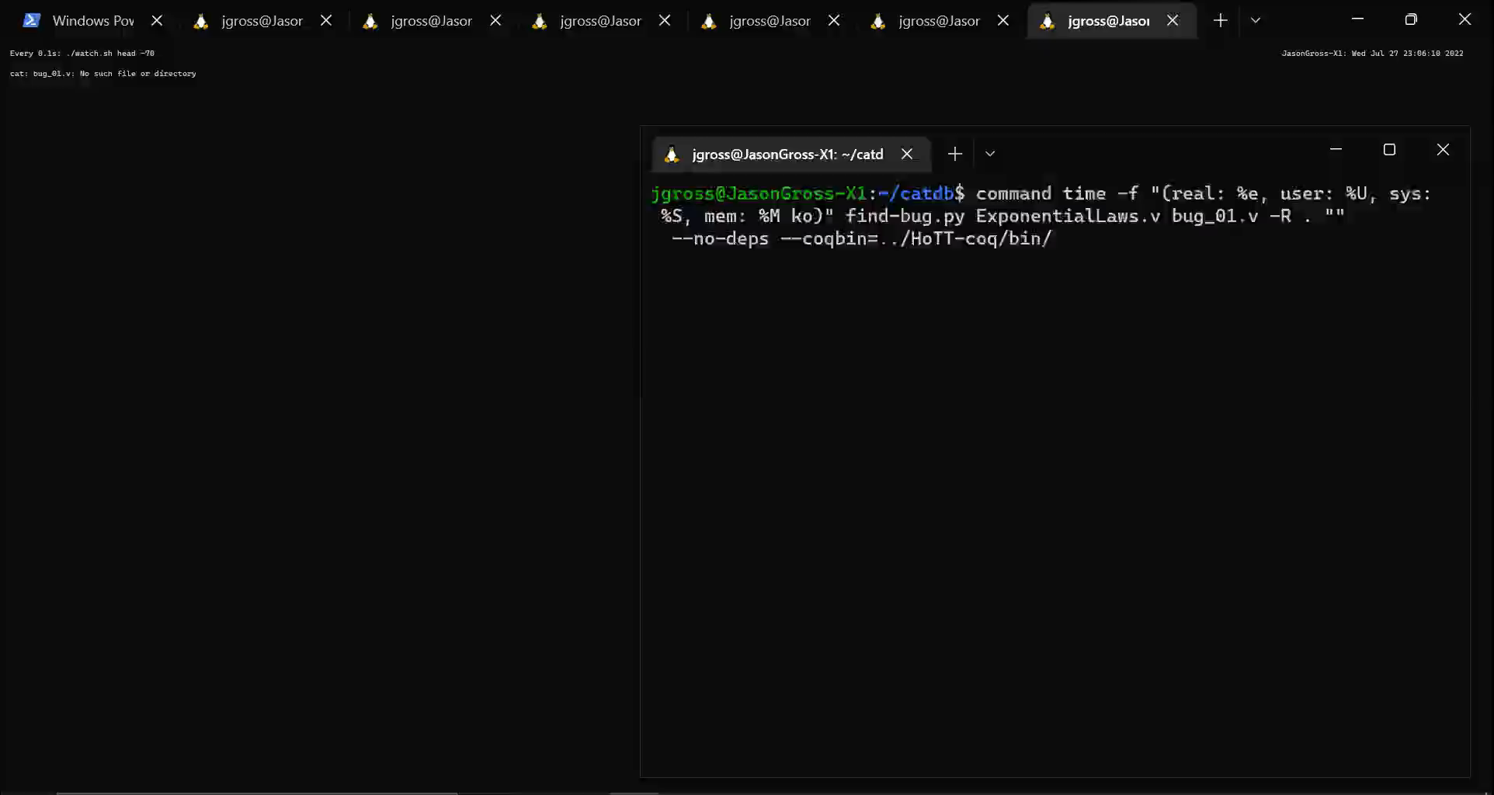
Notes:
Running at 8x
Took about 3.5 minutes
Some minor tricks for adequate performance, but at it’s core it’s just brute force

Slide 15
Debugging Regressions: coqdev experience
Notes:
I originally developed this tool to help me minimize freshly discovered bugs.
Now that I’m a coqdev, I also see this from the other side, making changes to Coq and having that introduce regressions that need to be debugged.

Slide 16
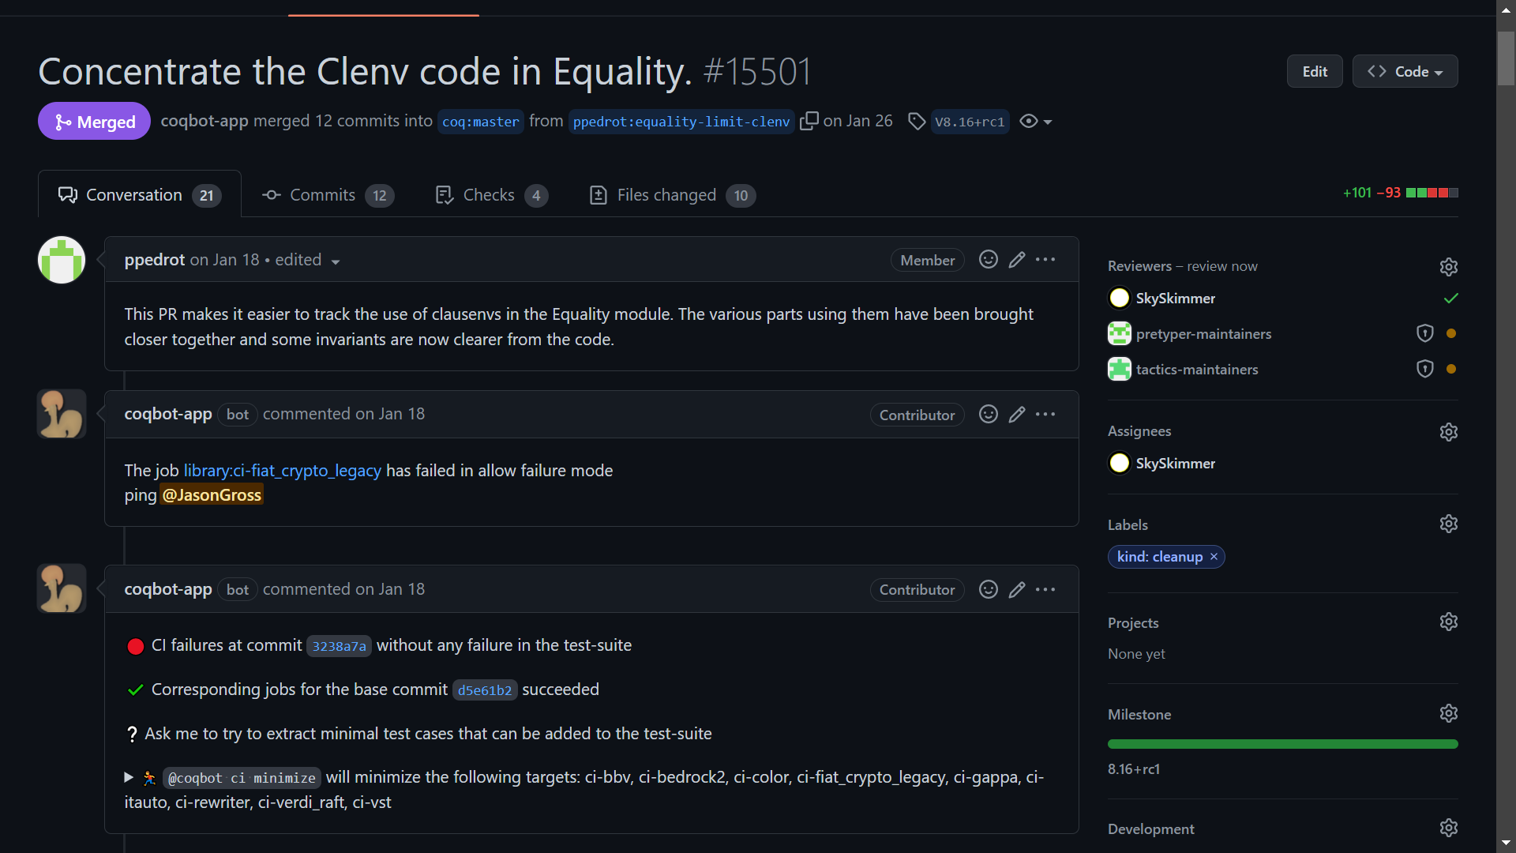

Notes:
“Broke” means project no longer compiles
Test 75 projects in the ecosystem
Often takes 2—4 hours for the CI to complete and coqbot to reply

Slide 17
CI Running Time
Notes:
Failed pipelines in red, succeeding pipelines in green; many red dots are hidden by green dots.

Slide 18
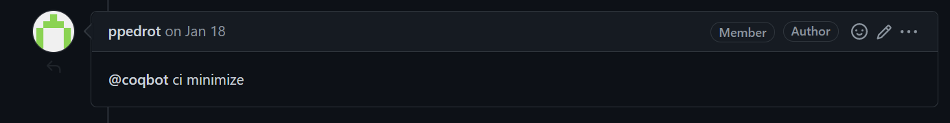
Notes:
“Broke” means project no longer compiles
Test 75 projects in the ecosystem
Often takes 2—4 hours for the CI to complete and coqbot to reply

Slide 19
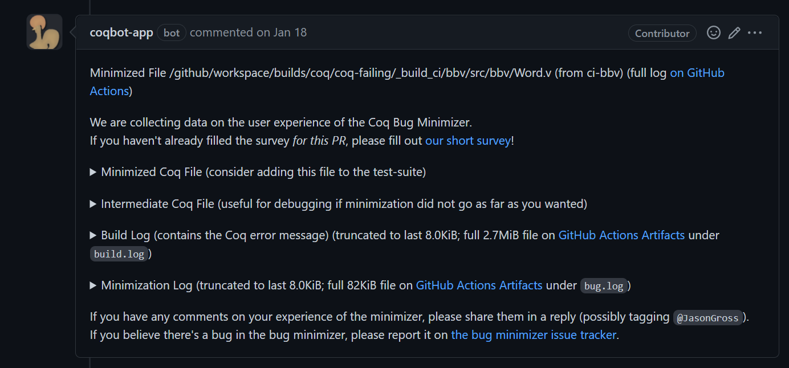

Slide 20
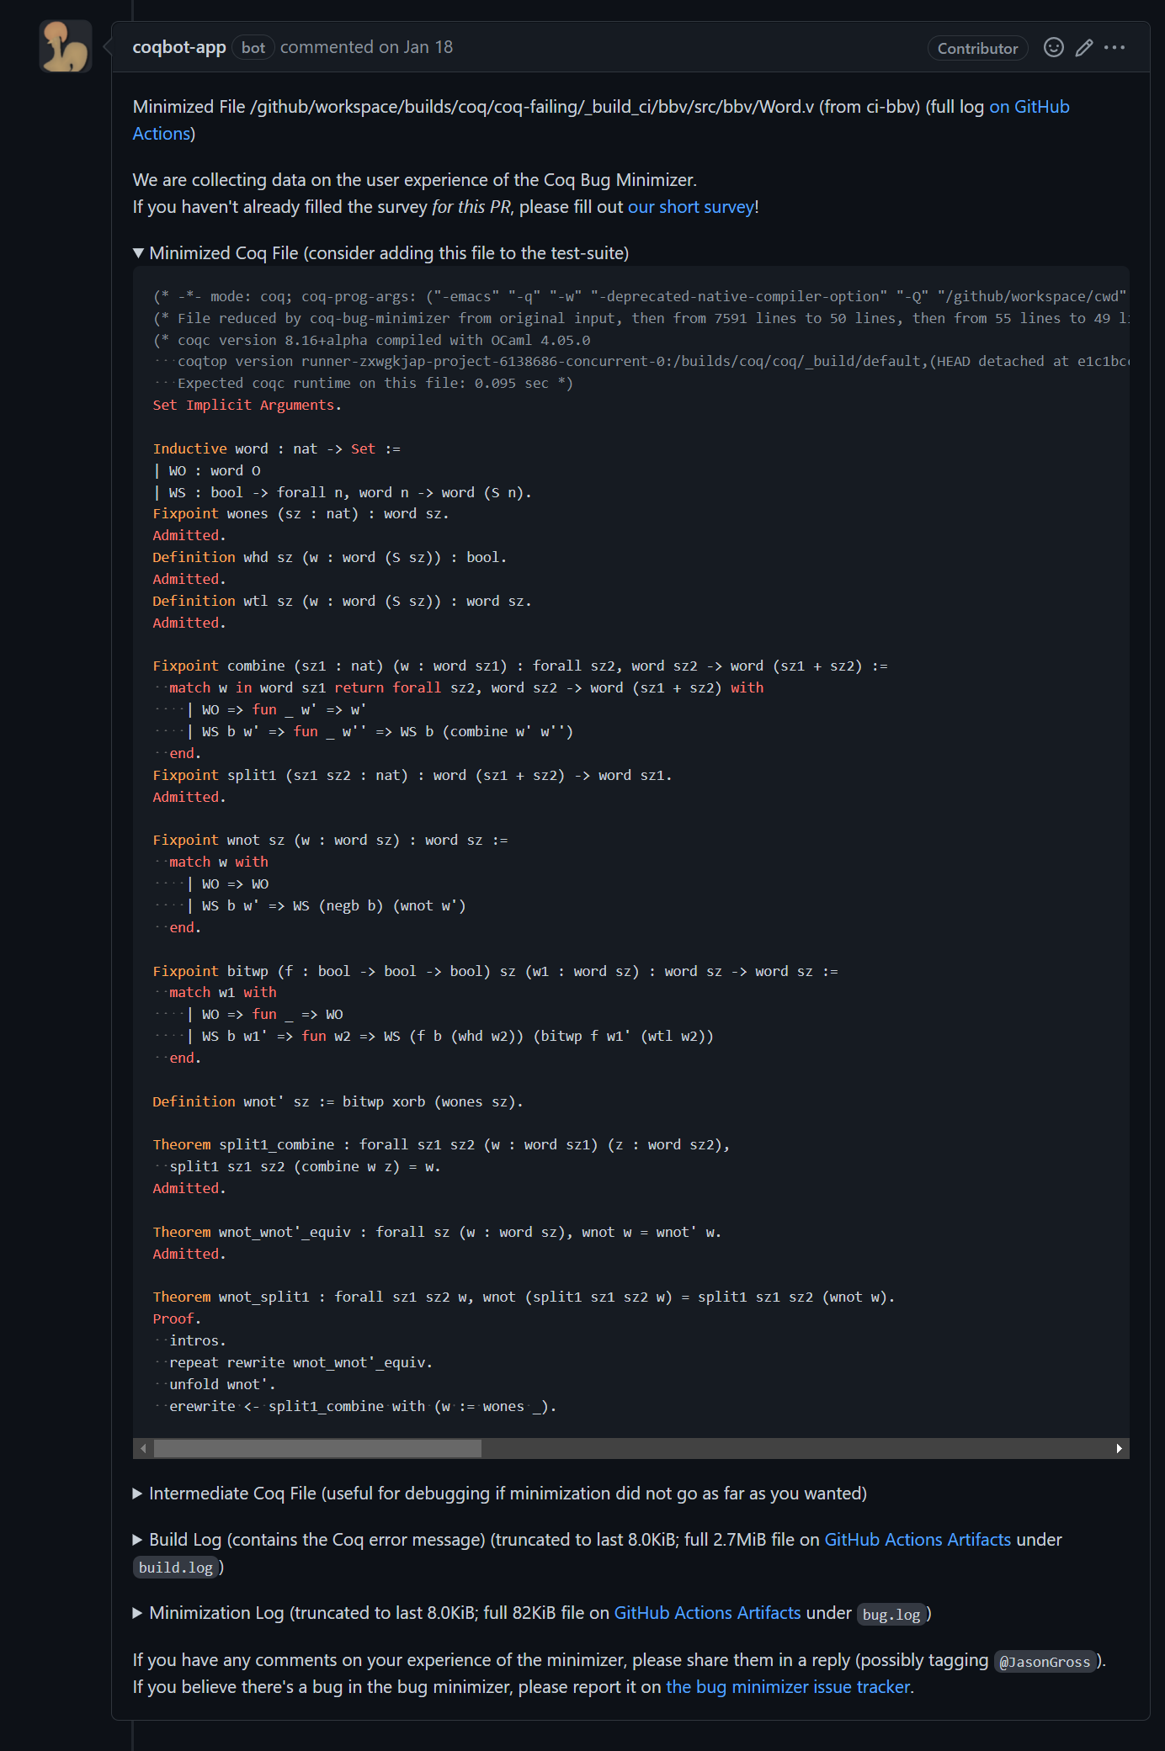

Slide 22
How Long Does It Take?

Slide 23
Minimizer Running Time CDF
Notes:
The minimizer succeeds on about 85% of cases where it is invoked---most failures are from earlier on when I was still debugging CI integration.
(Possibly note: increased adoption from CI integration => quicker debugging)
25% of runs succeed within 11 minutes
Almost 50% within half an hour
Almost 75% within 2 hours
90% within 6 hours
Over 95% within 12 hours
No runs yet that succeeded and took more than a day

Slide 24
How Long Do Projects Take On CI?
Selected CI Jobs, January through July 2022
Modified box plot for seven-number summary + mean
Notes:
When the pipeline takes a couple hours to run, it’s going to interrupt your testing workflow.
Given that all it takes to run the minimizer is leaving a comment, another couple of hours, or even a day, is not going to make much difference.
Box displays from 25% to 75%
Horizontal line at median
X at mean
Whisker extends from 2.15% to 97.85%
Whisker hash mark at 8.87% and 91.13%
See https://en.wikipedia.org/wiki/Seven-number_summary#Seven-number_summary

Slide 25
How Much Do We Minimize?
Better
Notes:
How much we minimize is a proxy for how useful minimization is.
LoC:
Over 60% of runs achieve an order-of-magnitude reduction in the number of LoC.
30% achieve a 100x reduction or more
We start at less than 100% because the rare minimization run ends up making the code longer; the minimizer has a couple of passes that insert newlines in select places, and if it’s unable to remove anything, this could make the code longer.
Time:
Final running time / CI failure time
50% achieve a reduction of nearly 1000x
Over 90% achieve a reduction of at least 200x

Slide 26
How Minimal is Minimal in Absolute Terms?
Better
Notes:
Almost 80% of minimized test-cases take at most a second to run
Almost 95% run within 10 seconds
Almost 80% have at most 100 LoC

Slide 27
Specification Summary
Input: a development displaying a potential problem with Coq
Output: a single (shorter, faster) file displaying the same behavior
Desires:
File should be standalone, as short as possible, as fast as possible
Fully automated, no interaction beyond pointing it at the issue initially
Interruptible and resumable: user should be able to do a manual pass over the file at any point and resume automatic minimization from there
Notes:
Talk about problem being only potential, e.g., replacing “1 + 1” as real in goal (0 = sin(pi * (1 + 1))) vs nat
Possibly note: final bullet (interruptible) doesn’t contain any conceptual challenges and is relatively straightforward, if quite useful, to implement

Slide 28
Specification Details
What does “the same behavior” mean?
In bug reporting case: “same” error message, without changing the final bit of code
“print ‘exact error message’” is not a valid minimization
In CI case: should also succeed on the master version of Coq

Slide 29
What needs to be automated?
Workflow automation (responding to user’s comment, replying as a comment)
Removing code to shorten example (in compile time and LoC)
Adjustments to minimize compile time
Inlining and linearization (to reduce complexity)

Slide 30
How do we do this?
Interfacing with Coq externally
Delta debugging / brute force
Tricks for inlining
To Achieve Adequate Performance:
Inline files one-by-one
Remove proof scripts as early as possible
Linear pass to remove code, don’t consider all subsets
Notes:
“three main techniques” (for adequate performance)

Slide 31
Delta Debugging / Brute Force Removal
“Trust me, it’s true” primitives
Not line by line, but blocks
Minimal coupling, lack of forward references
Notes:
(not line by line – removing the middle statement of a theorem)
shouldn’t expect … “valid, let alone true”

Slide 32
Coupling
Coupling in Agda:
data ℕ : Set where
zero : ℕ
succ : ℕ → ℕ
data Even : ℕ → Set
data Odd : ℕ → Set
data Even where
even-zero : Even zero
even-succ : ∀ {n} → Odd n → Even (succ n)
data Odd where
odd-succ : ∀ {n} → Even n → Odd (succ n)
Notes:
It’s not valid to remove just one of them, and we can insert other statements between the data declaration and the body.

Slide 33
Coupling
Coupling in Agda:
data ℕ : Set where
zero : ℕ
succ : ℕ → ℕ
data Even : ℕ → Set
data Odd : ℕ → Set
data Even where
even-zero : Even zero
even-succ : ∀ {n} → Odd n → Even (succ n)
data Odd where
odd-succ : ∀ {n} → Even n → Odd (succ n)
Missing type signature for data definition Even
when scope checking the declaration
…
Not in scope:
Odd
when scope checking Odd
The following names are declared but not accompanied by a definition: Odd
The following names are declared but not accompanied by a definition: Even
Notes:
It’s not valid to remove just one of them, and we can insert other statements between the data declaration and the body.

Slide 34
Coupling
✓
Coupling in Agda:
data ℕ : Set where
zero : ℕ
succ : ℕ → ℕ

Slide 35
Coupling
Coupled definitions are almost always single statements in Coq
Inductive ℕ : Set :=
| zero : ℕ
| succ : ℕ -> ℕ.
Inductive Even : ℕ -> Set :=
| even_zero : Even zero
| even_succ : forall {n}, Odd n -> Even (succ n)
with Odd : ℕ -> Set :=
| odd_succ : forall {n}, Even n -> Odd (succ n).
Notes:
In Coq, the entire block is a single statement, and it’s not possible to insert other statements in the middle

Slide 36
How do we do this?
Interfacing with Coq externally
Delta debugging / brute force
Tricks for inlining

Slide 37
Tricks for Inlining and Linearization

Slide 38
Name Changes on Inlining
A.v:
Definition foo
: nat := 0.
Definition foo
: nat := 0.
Definition foo
: nat := 1.
(* Error: foo already exists. *)
Print foo.
(*foo = 1 : nat*)
Print A.foo.
Module A.
Definition foo
: nat := 0.
End A.
Import A.
Definition foo
: nat := 1.
Print foo.
(*foo = 1 : nat*)
Print A.foo.
(*A.foo = 0 : nat*)
vs
B.v:
Require Import A.
Definition foo
: nat := 1.
Print foo.
(*foo = 1 : nat*)
Print A.foo.
(*A.foo = 0 : nat*)
Notes:
When inlining a file, names can change …
(don’t spend too much time explaining things here)

Slide 39
Linearization
A.v
B.v
A.v
B.v
B.v
or
A.v
?
C.v
C.v
C.v
Notes:
The most important consideration in inlining, though, is linearization
About 86% of the files the minimizer produces are fully standalone

Slide 40
How to make your proof assistant amenable to minimization
Make it possible to have a single file with the same semantics as code in multiple files
Primitive for “trust me, it’s true”
Lack of forward references is nice
Don’t forget the last mile of automating integration with CI!
Notes:
Note: when we integrated the minimizer with coqbot, the number of apparent uses and users of the minimizer drastically increased.
Note: increased usage led to quicker improvement of the minimizer itself

Slide 41
Future Work
More automation of bug reporter work flow
Better inlining
More minimization
Other proof assistants???
Notes:
Note: While I don’t have concrete plans to extend this tool to other proof assistants, I’m happy to act as an advisor.
(I did start working on a Lean port, but didn’t get very far for lack of available time.)

Slide 43
Extra Content

Slide 44
How Long Do Projects Take On CI?
Selected CI Jobs, January through July 2022
Modified box plot for seven-number summary + mean
Notes:
When the pipeline takes a couple hours to run, it’s going to interrupt your testing workflow.
Given that all it takes to run the minimizer is leaving a comment, another couple of hours, or even a day, is not going to make much difference.
Box displays from 25% to 75%
Horizontal line at median
X at mean
Whisker extends from 2.15% to 97.85%
Whisker hash mark at 8.87% and 91.13%
See https://en.wikipedia.org/wiki/Seven-number_summary#Seven-number_summary

